Slide 1
NLTK
PRESENTED BY:JERRINA ANN SIMON

Slide 2
Introduction And Installation Of NLTK
Natural Language Toolkit or NLTK is an open-source toolkit for NLP tasks.
Natural Language Processing (NLP) is defined as the field that focuses on enabling the computer to understand and process the natural human language.
One of the powerful NLP libraries that contain packages to make machines understand human languages and respond appropriately.
provides easy-to-use interfaces to over 50 corpora and lexical resources, such as WordNet, along with a suite of text processing libraries for classification, tokenization, stemming, tagging, parsing, and semantic reasoning.
Install the library using pip or conda using the command: pip install nltk
Verify the installation by importing the NLTK package using the command import nltk
Run nltk.download( ) This will download the dictionaries other languages and other grammar data frames necessary for NLTK functionality.

Slide 3
Application Cases
NLTK library contains the Inaugural Address Corpus with speeches from 1789 to 2017 with 59 texts and a total number of 149,797 words.
Organized into independent subtexts based on the age of the speeches.
Takes Inaugural Address Corpus as the object of English study.
It introduces how NLTK aids in natural language processing, allowing researchers to analyze linguistic patterns, evolution, and trends within these historical speeches.

Slide 4
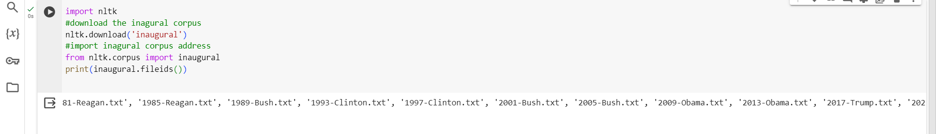
Corpus Import
The inaugural address corpus is derived from the NLTK library for NLP tasks.
Import the corpus using the 'import' command
Each corpus in NLTK contains multiple files or documents.
Corpus field() method is used to get the list of files.

Slide 5
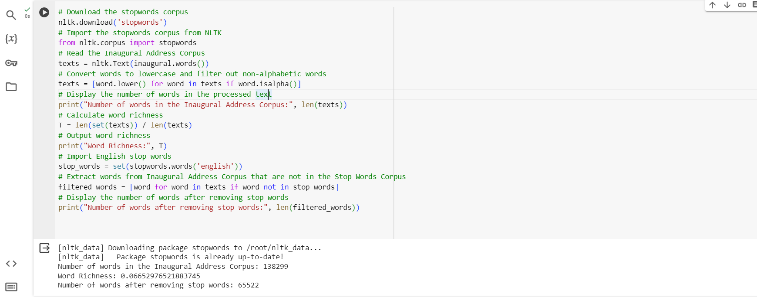
Text Preprocessing
Texts in the corpus are often unstructured and may contain nonstandard formats like punctuation, case sensitivity, special symbols, and extra spaces.
the process involves acquiring the original corpus, cleaning and pre-processing the text to address nonstandard formats, tokenizing the cleaned text into words, and applying further cleaning by filtering out stop words to improve data accuracy for subsequent analysis.

Slide 6
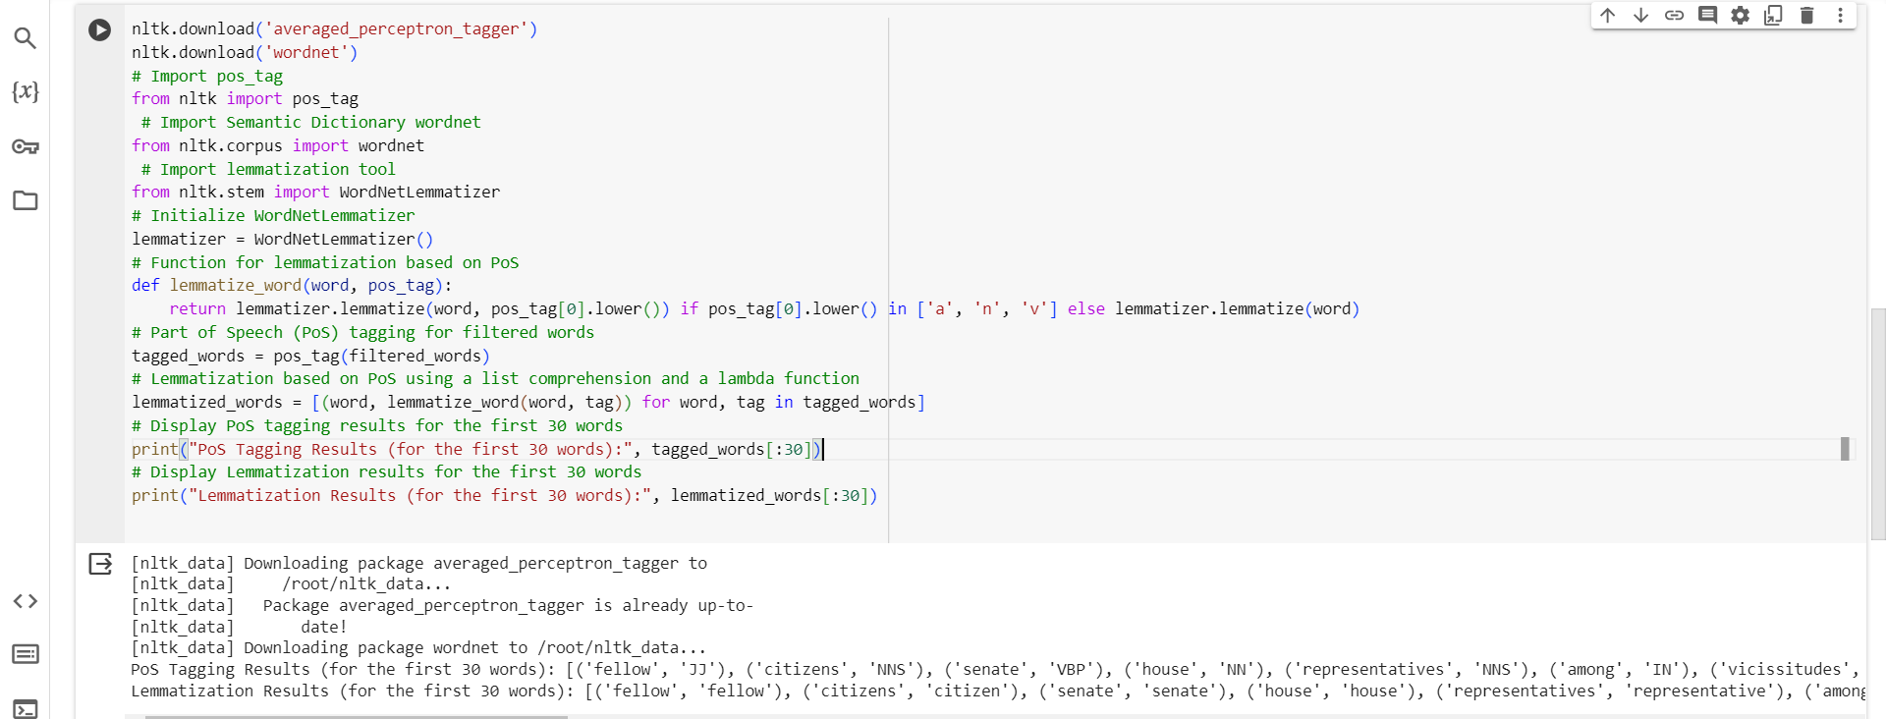
Part of Speech Tagging And Lemmatisation
POS tagging is the process of assigning grammatical tags to each word in a sentence.
Lemmatisation reduces words to their base word, reducing the inflected words properly and ensuring that the root word (lemma) belongs to the language.

Slide 7
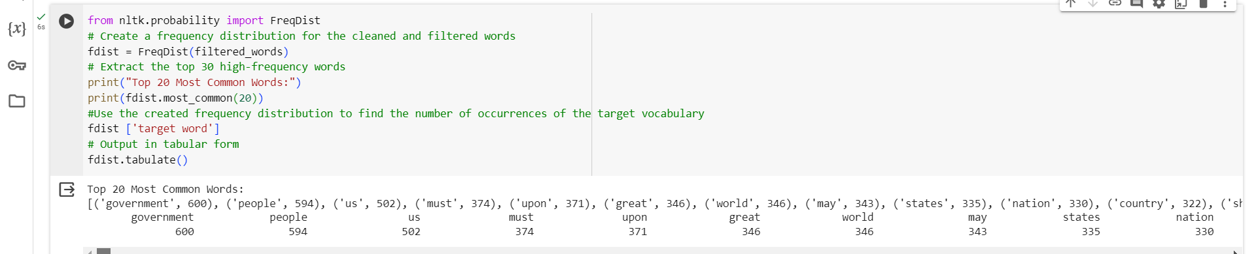
Data Analysis
Probability statistics is a commonly used mathematical analysis method in NLTK for processing and analyzing textual data.
NLTK's FreqDist() function is utilized for word frequency statistics, enabling the extraction and tabulation of high-frequency words in a given text.

Slide 8
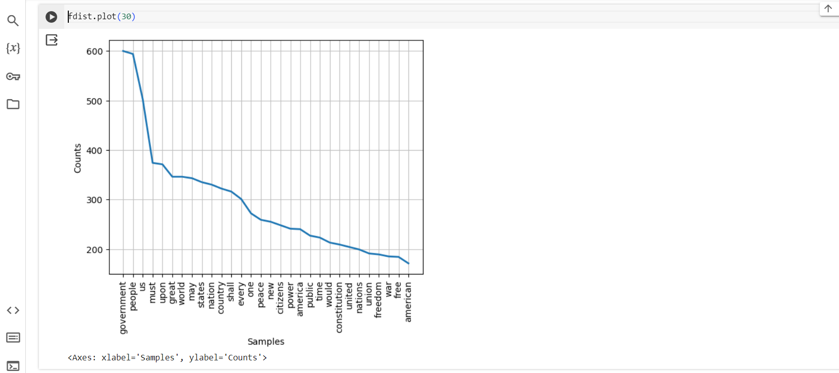
Graphic Display
Matplotlib is a Python library for visualization that can be employed to create various statistical charts for structured data.
The statistical data obtained in the previous code( using NLTK for word frequency) can be displayed in the form of a frequency line chart.

